Slide 1
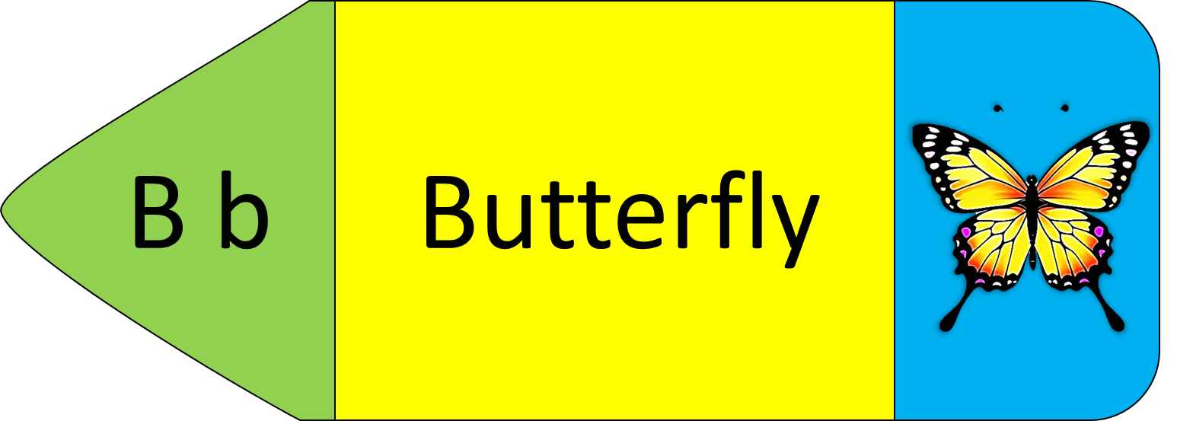
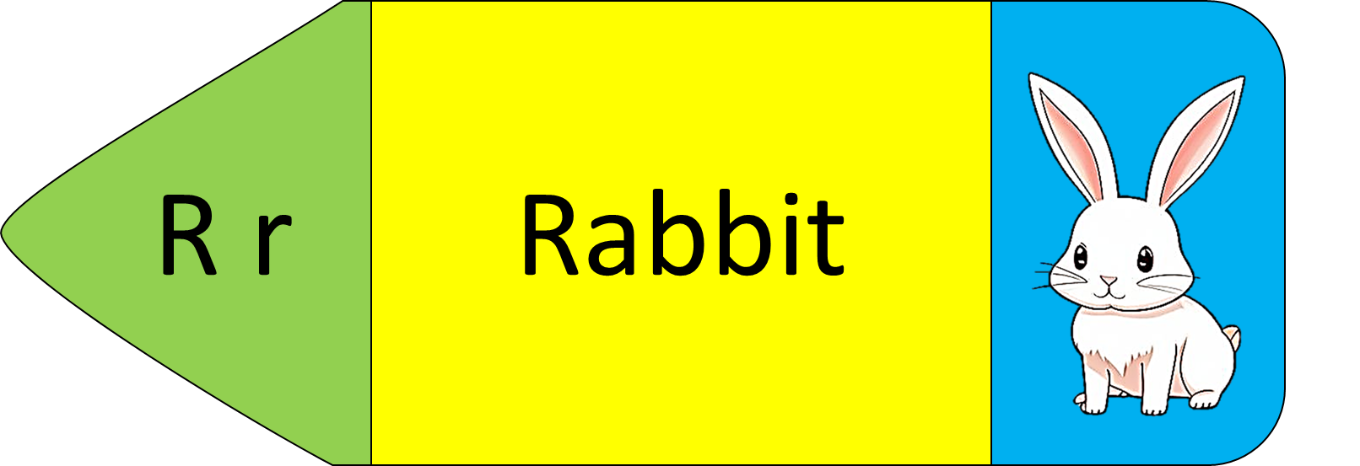
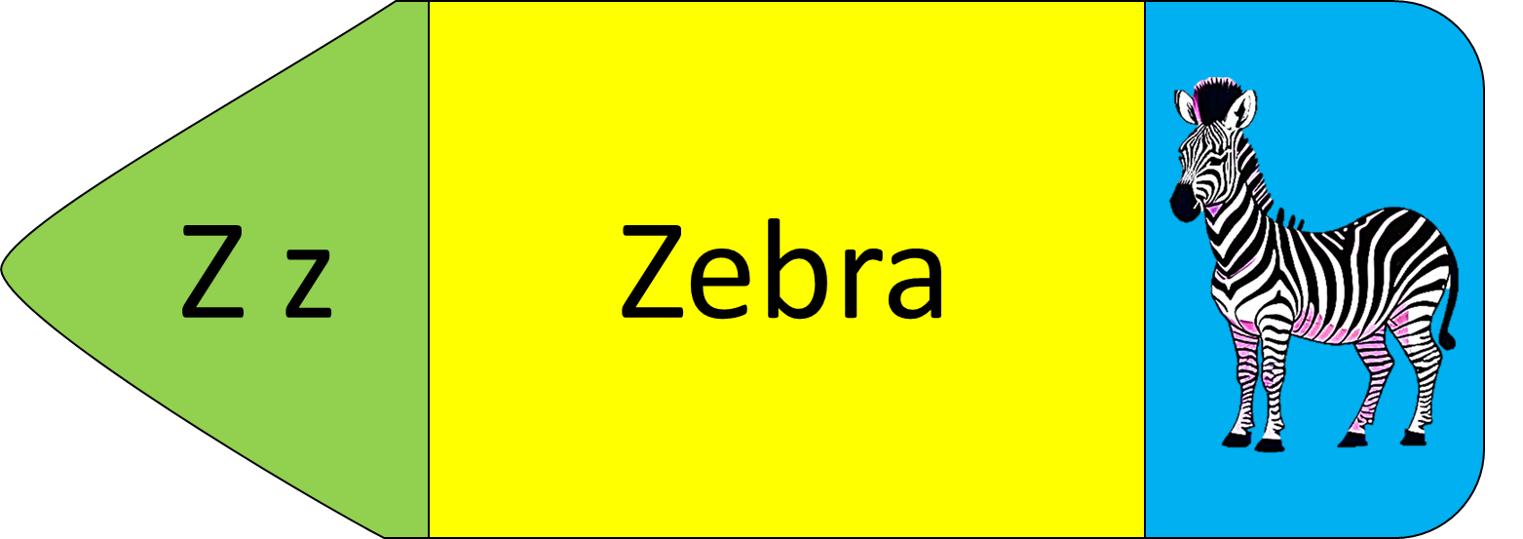
Alphabet Fun
Cut and Sort

Slide 2
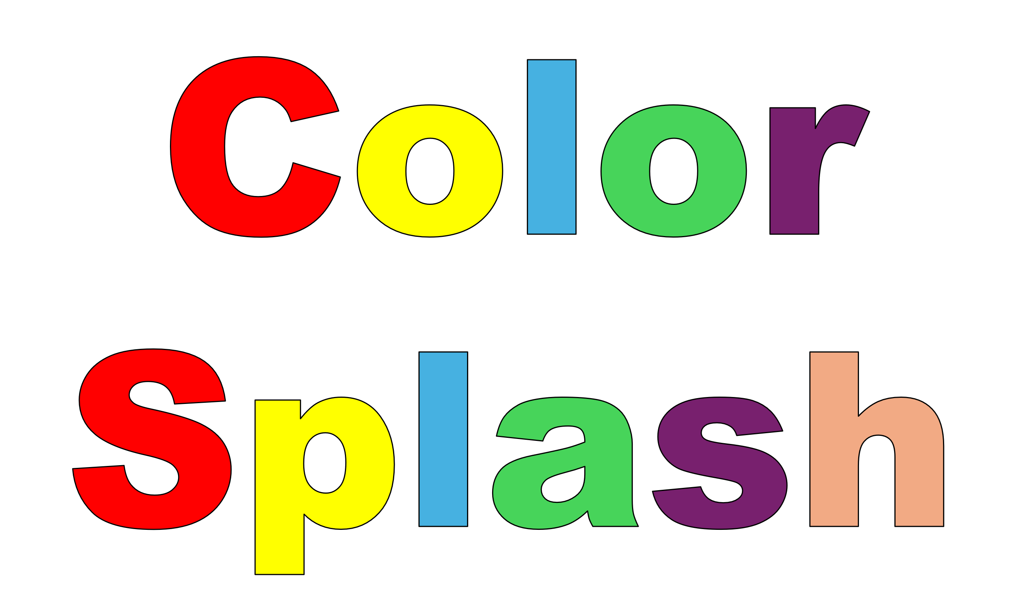
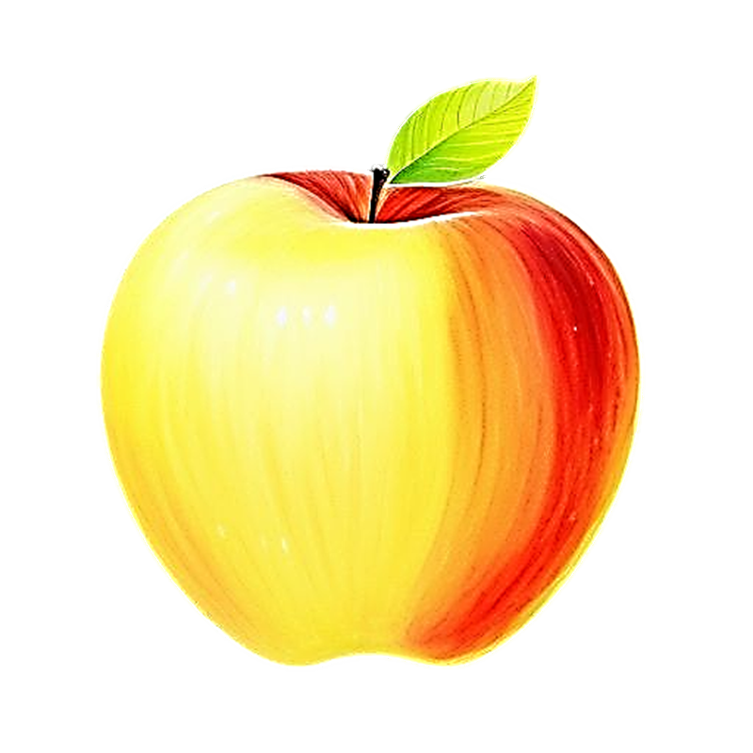
Color Splash
Blossomings.github.io
A a
Apple
Color Splash

Slide 3

Blossomings.github.io
B b
Butterfly
Color Splash

Slide 4
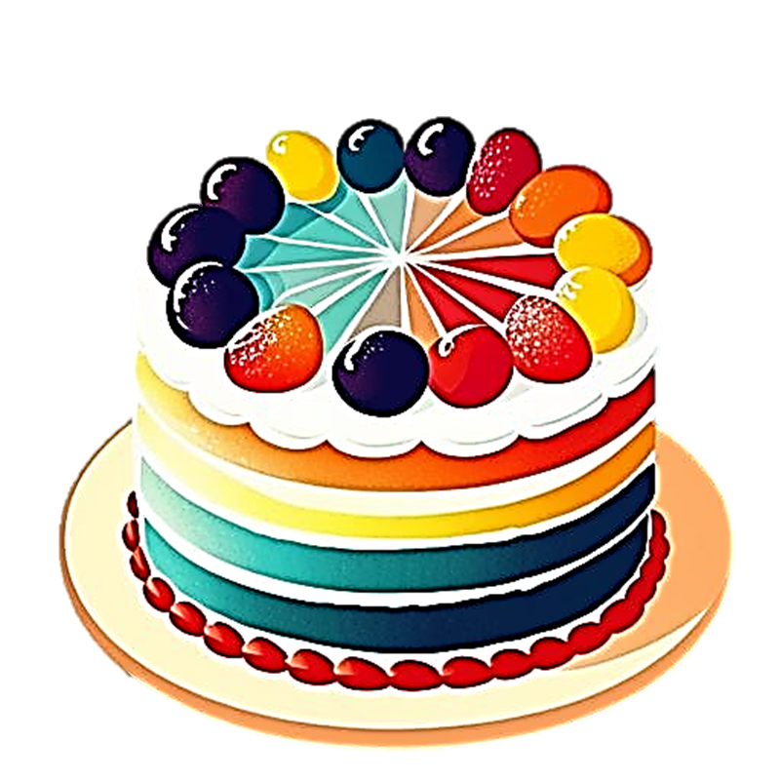
Blossomings.github.io
C c
Cake
Color Splash

Slide 5
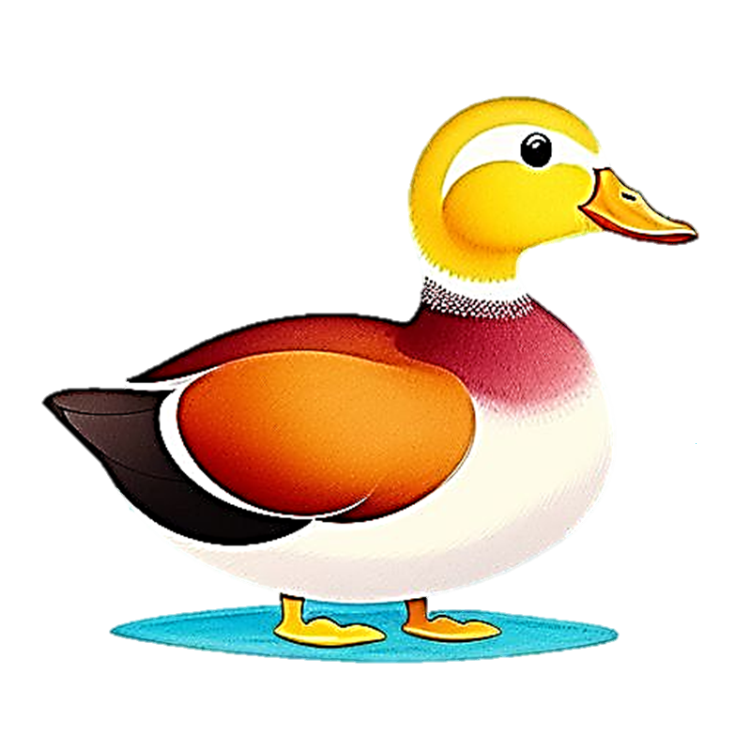
Blossomings.github.io
D d
Duck
Color Splash

Slide 6

Blossomings.github.io
E e
Egg
Color Splash

Slide 7
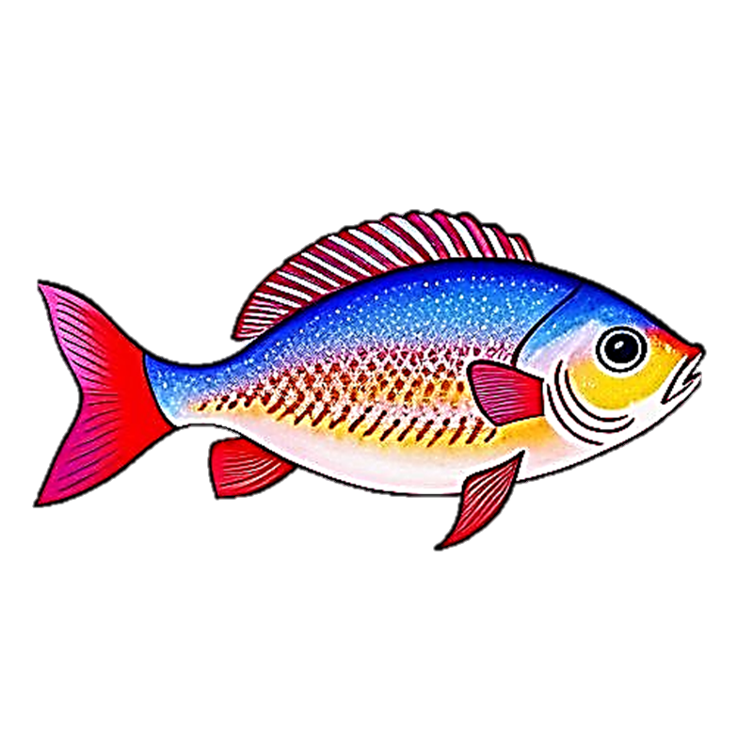
Blossomings.github.io
Color Splash
F f
Fish

Slide 8
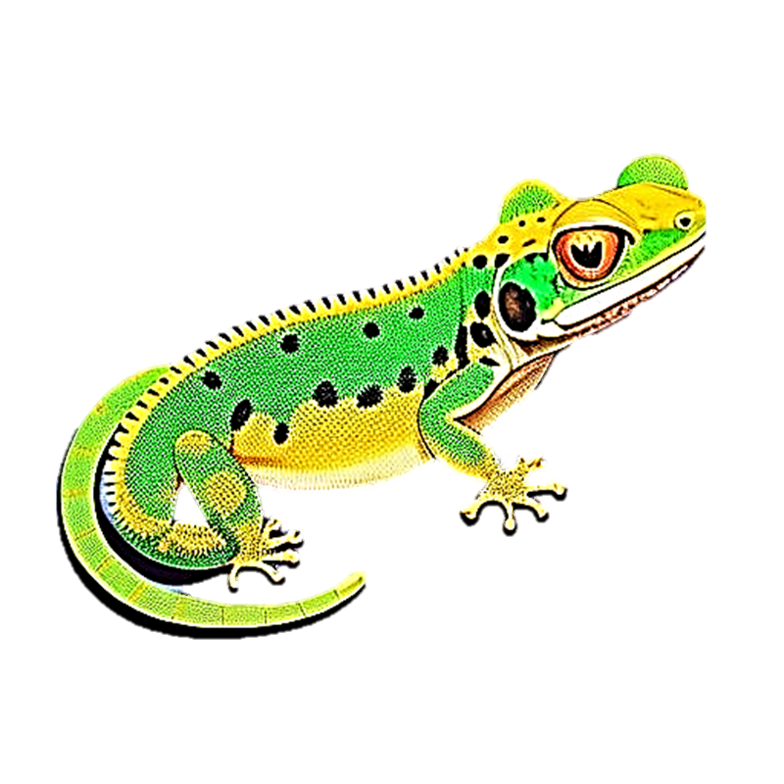
Blossomings.github.io
G g
Gecko
Color Splash

Slide 9
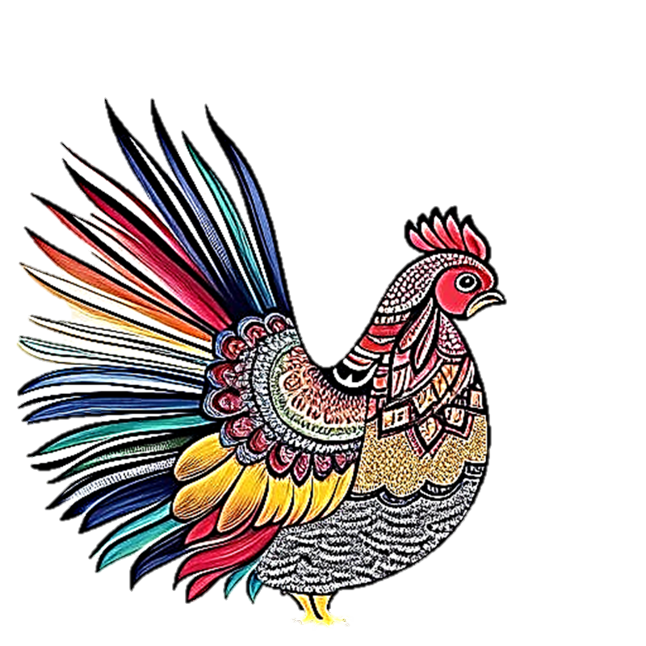
Blossomings.github.io
H h
Hen
Color Splash

Slide 10
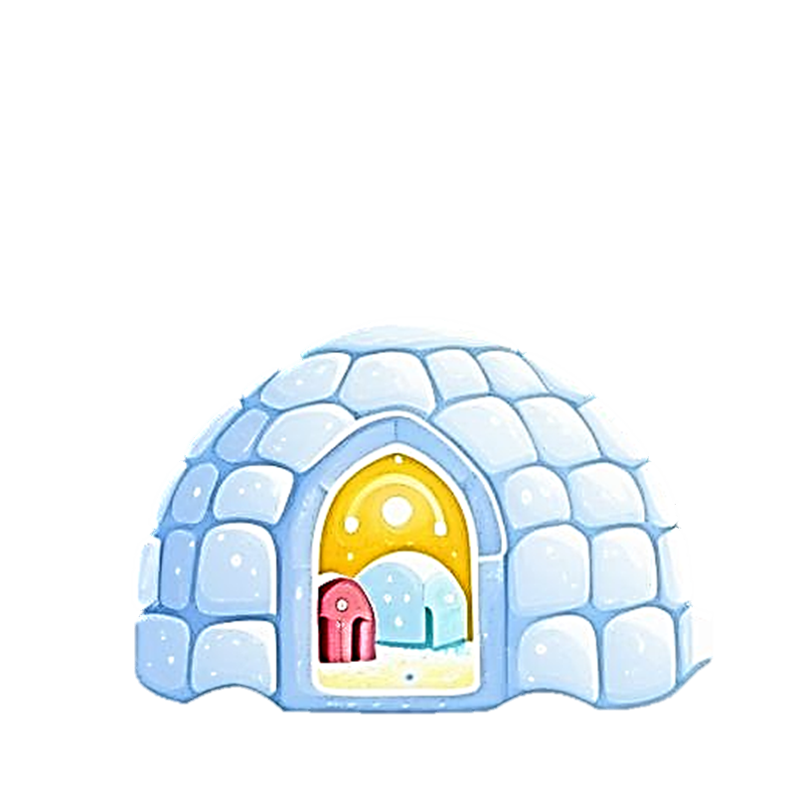
Blossomings.github.io
I i
Igloo
Color Splash

Slide 11
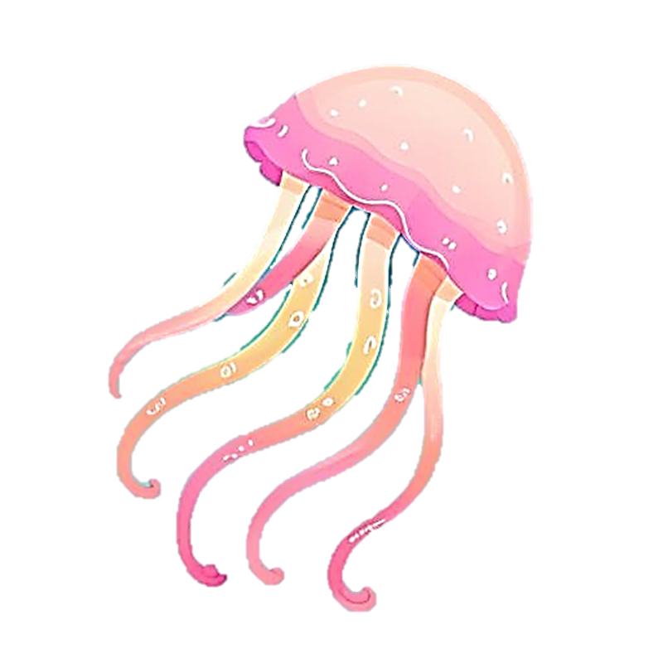
Blossomings.github.io
J j
Jellyfish
Color Splash

Slide 12
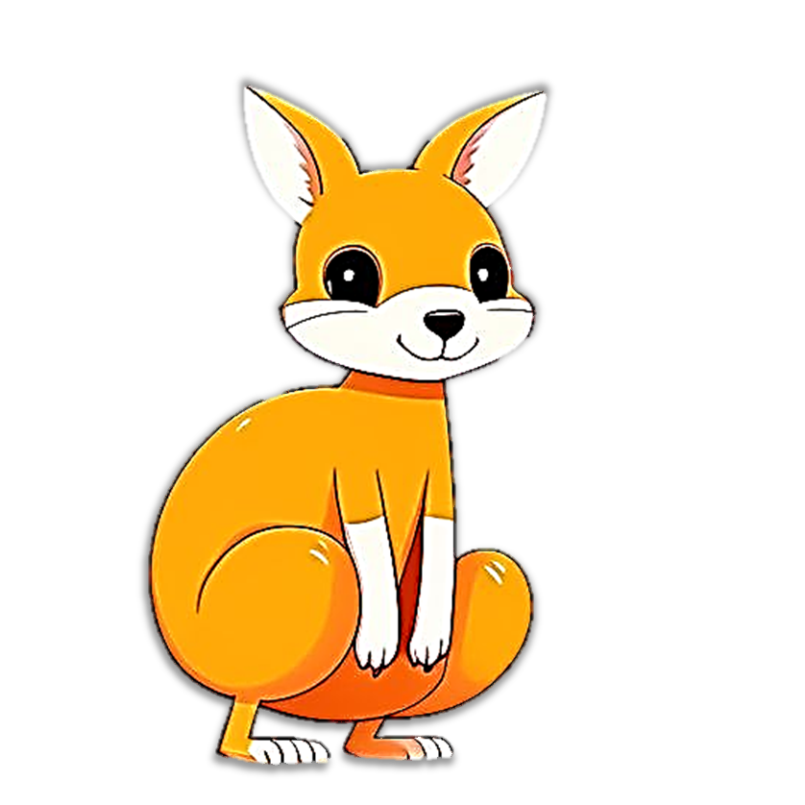
Blossomings.github.io
K k
Color Splash
Kangaroo

Slide 13

Blossomings.github.io
L l
Lion
Color Splash

Slide 14
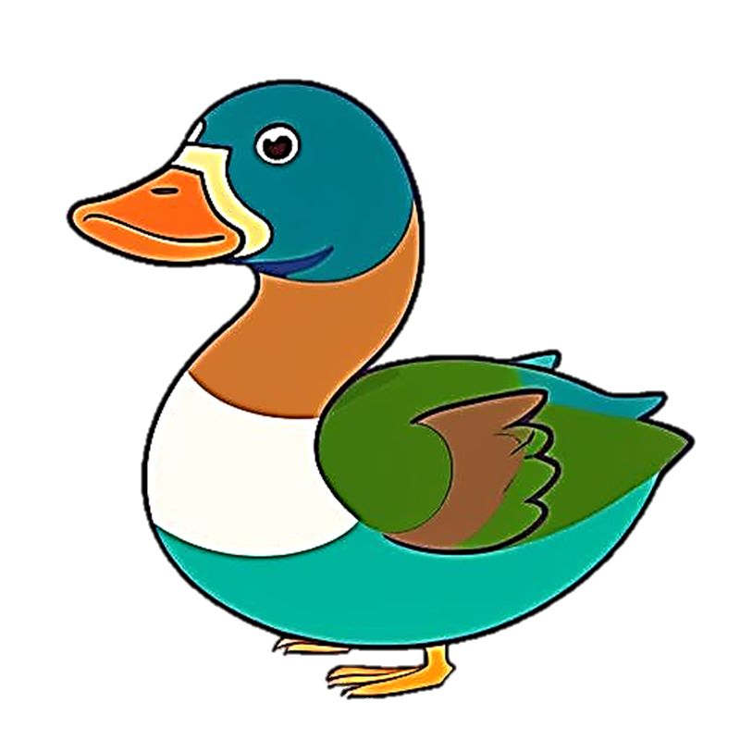
Blossomings.github.io
M m
Mallard
Color Splash

Slide 15
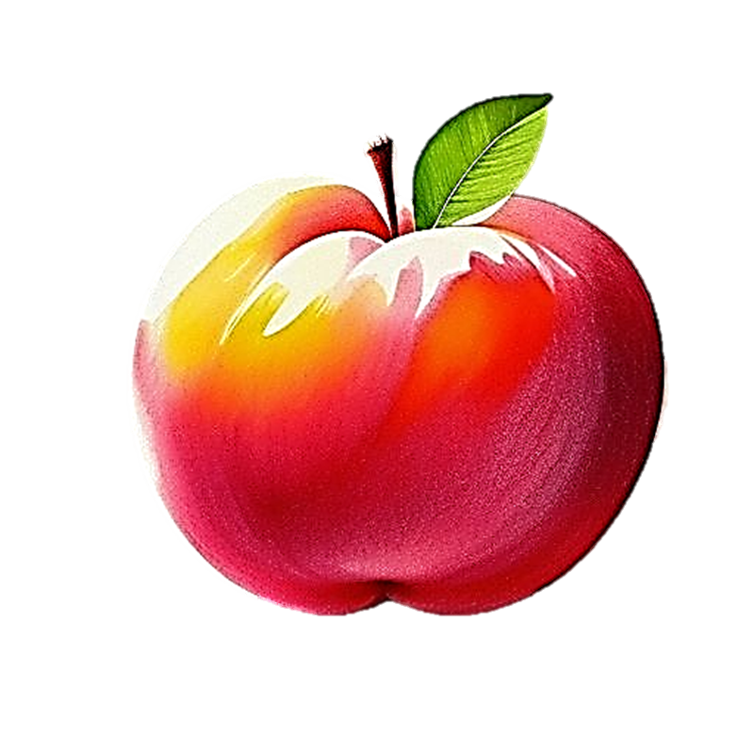
Blossomings.github.io
Color Splash
N n
Nectarine

Slide 16
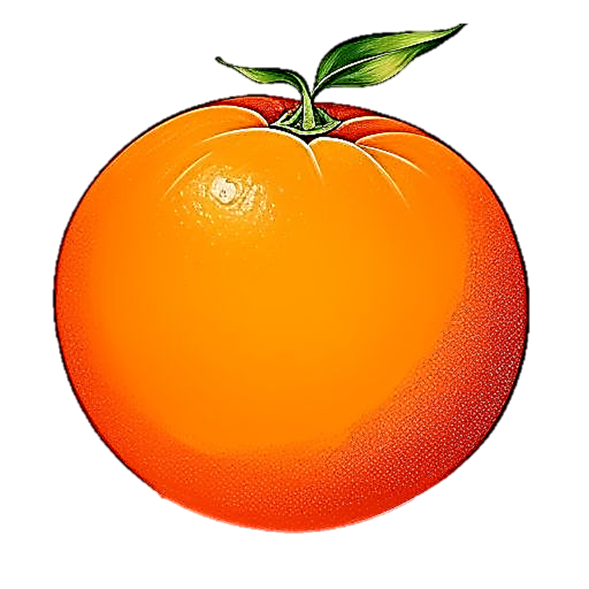
Blossomings.github.io
O o
Orange
Color Splash

Slide 17
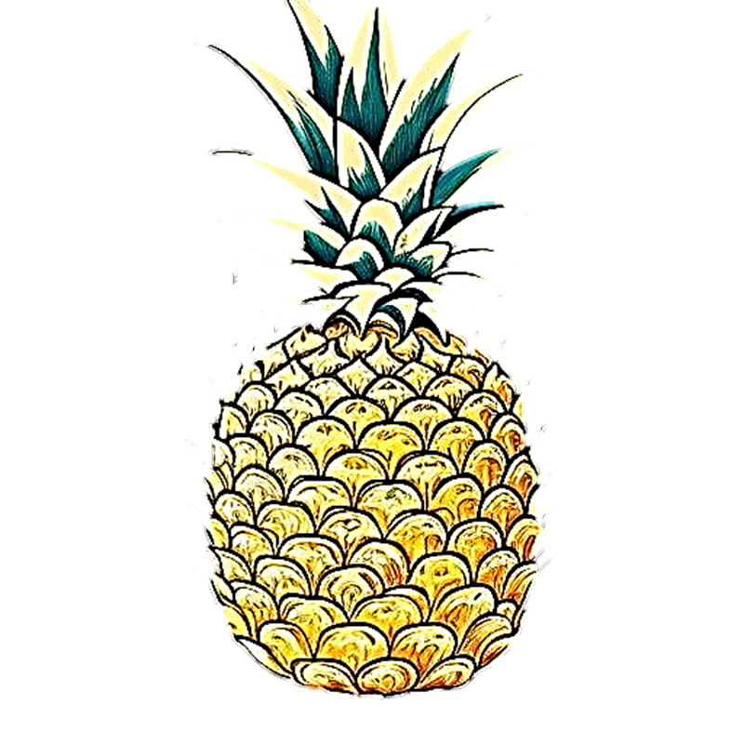
Blossomings.github.io
P p
Pineapple
Color Splash

Slide 18
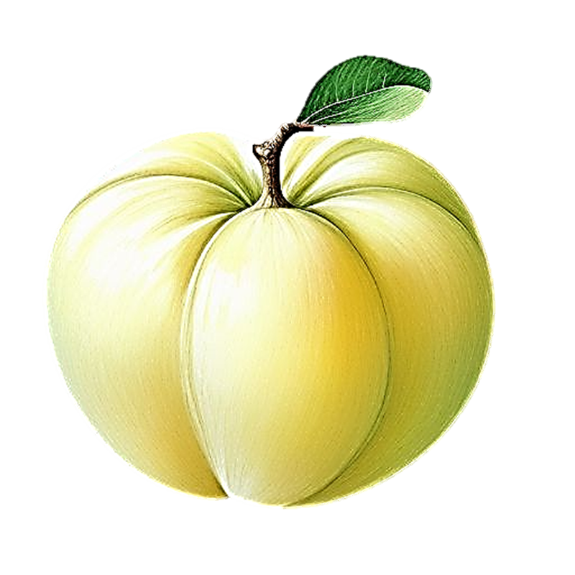
Blossomings.github.io
Q q
Quince
Color Splash

Slide 19
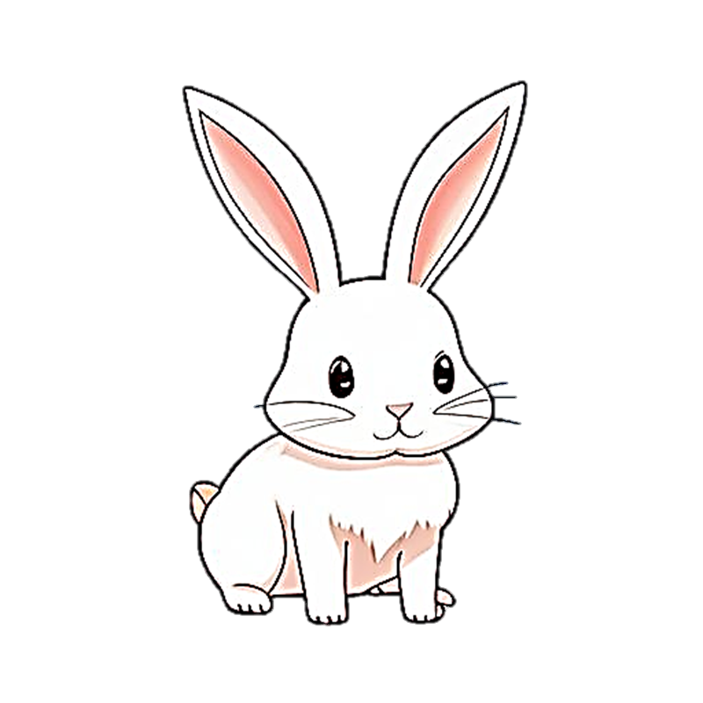
Blossomings.github.io
R r
Rabbit
Color Splash

Slide 20
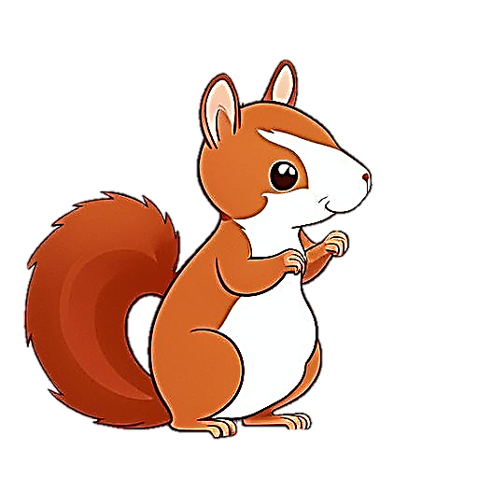
Blossomings.github.io
S s
Squirrel
Color Splash

Slide 21
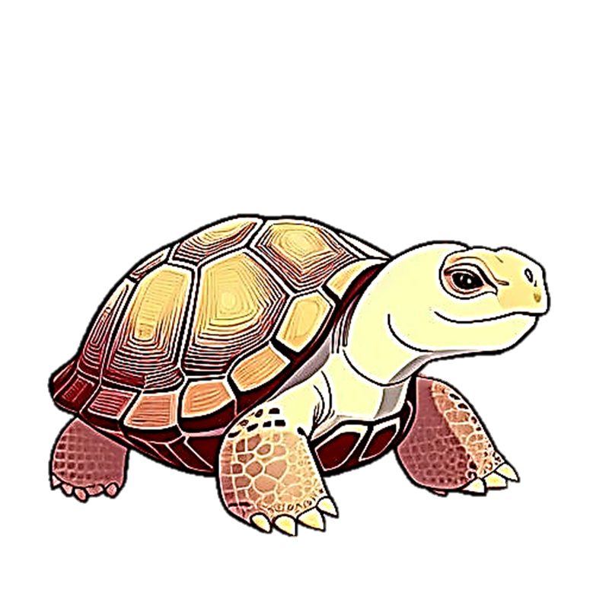
Blossomings.github.io
T t
Tortoise
Color Splash

Slide 22
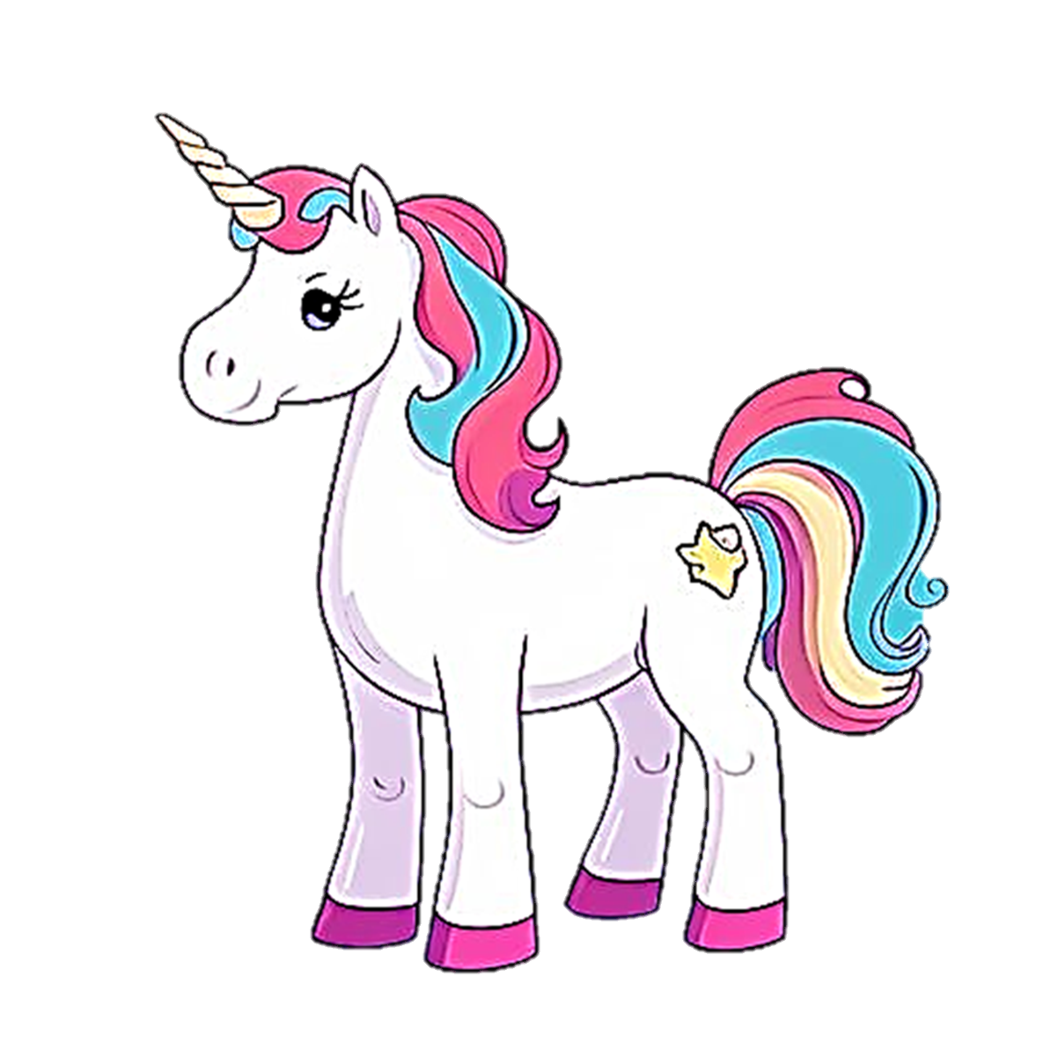
Blossomings.github.io
U u
Unicorn
Color Splash

Slide 23

Blossomings.github.io
V v
Van
Color Splash

Slide 24

Blossomings.github.io
W w
Whale
Color Splash

Slide 25
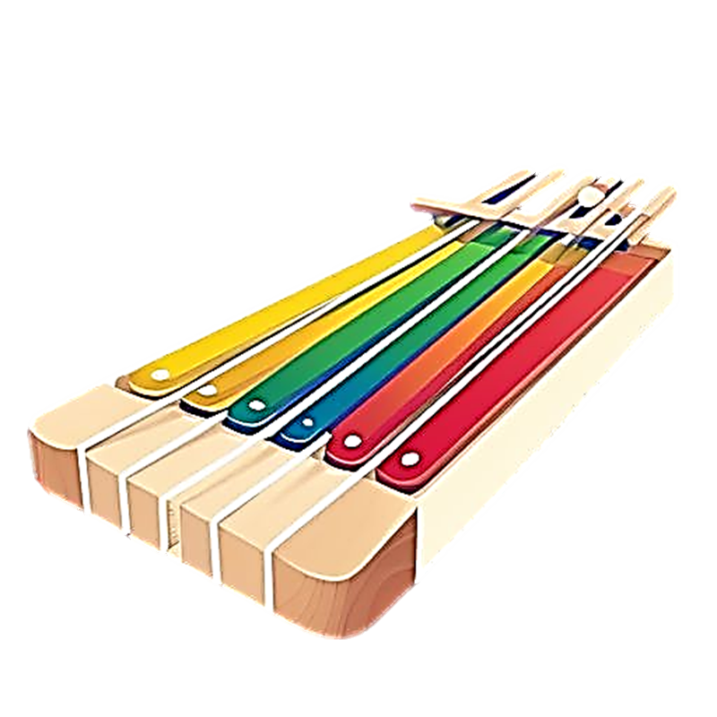
Blossomings.github.io
Color Splash
X x
Xylophone

Slide 26
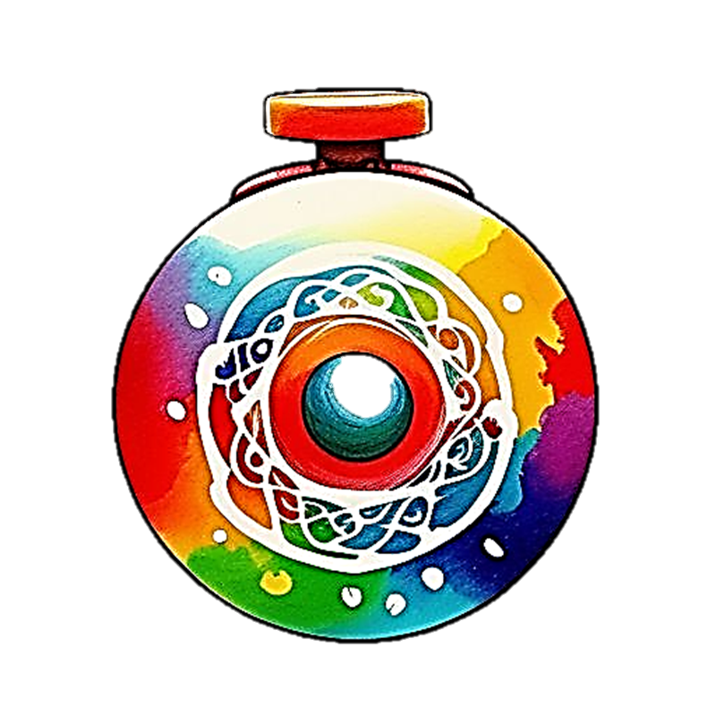
Blossomings.github.io
Y y
Yo-yo
Color Splash

Slide 27
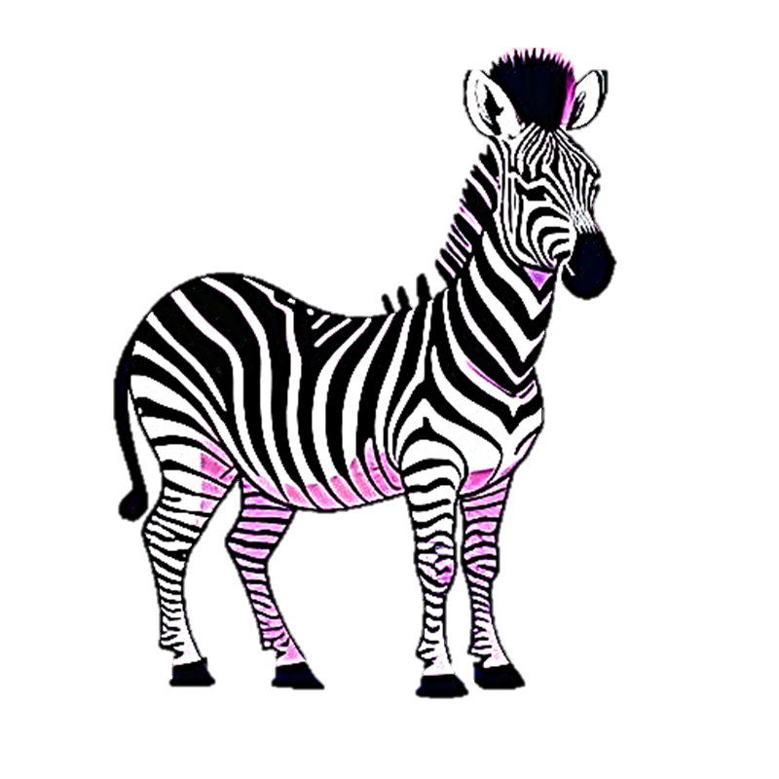
Blossomings.github.io
Z z
Zebra
Color Splash

